Slide 1
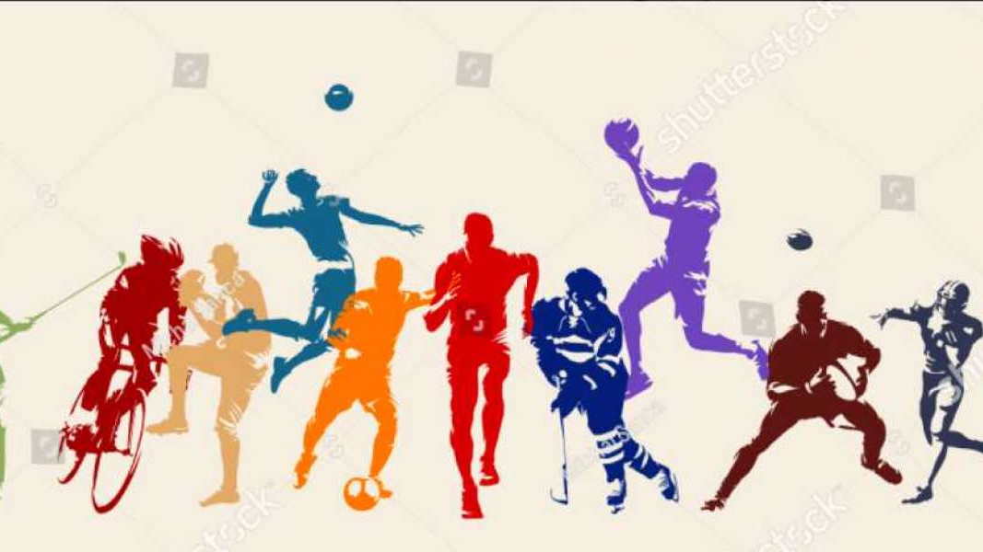
Sports Person Image Classifier

Slide 2
Introduction
Combining ML + CV + Web Dev
Using openCV managed various Computer vision for various tasks like:
Image preprocessing which involved resizing of the image
Normalizing
Augmenting the data to enhance the training set diversity and robustness
In the machine learning phase, I experimented with SVM, Random Forest, and Logistic Regression models, tuning their hyperparameters for optimal performance.
Evaluating the models involved assessing their accuracy and performance metrics to ensure the best outcomes.
Finally completed the work with flask server which is still in testing perpose.

Slide 3
Problem statement
Develop an automated sports celebrity recognition system that utilizes advanced computer vision and machine learning techniques to accurately classify images.
The goal is to enhance data preprocessing, optimize model performance, and create a user-friendly web application for real-time image prediction and identification.

Slide 4
Objectives
Image Preprocessing: Implement robust image preprocessing techniques, including resizing, normalizing, and augmenting, to enhance the quality and diversity of the training dataset.
Model Training and Optimization: Experiment with and fine-tune multiple machine learning models, such as SVM, Random Forest, and Logistic Regression, to determine the best-performing model for sports celebrity image classification.
Performance Evaluation: Conduct thorough evaluation of the trained models using appropriate performance metrics to ensure high accuracy and reliability in predictions.
Real-Time Prediction: Develop a user-friendly web application using Flask that allows users to upload images and receive real-time predictions of the sports celebrity depicted in the image.
Seamless Integration: Ensure a seamless integration of computer vision, machine learning, and web development to provide an interactive and efficient user experience.

Slide 5
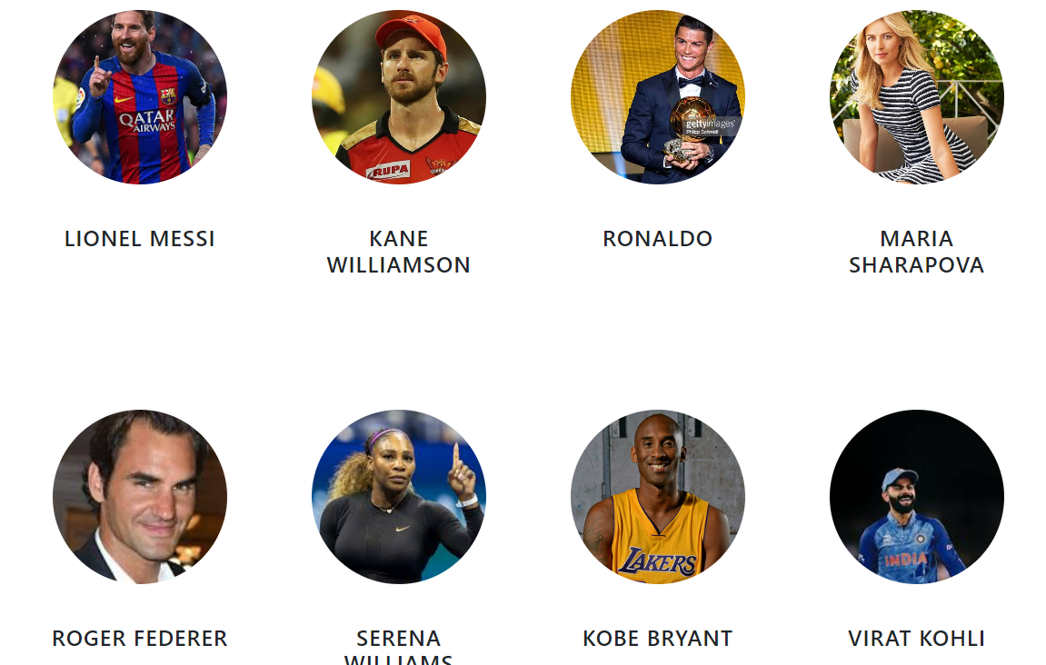
Dataset description
The dataset is taken from:
kaggle and
other resourses

Slide 6
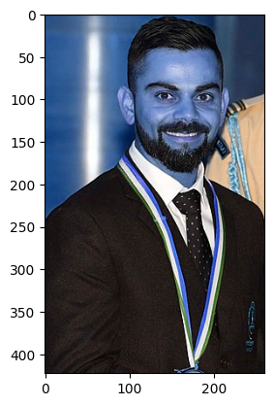
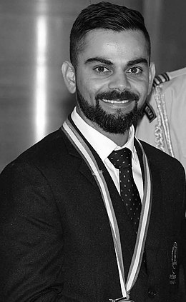
GrayScaling of Image converting an image from color to grayscale.

Slide 7
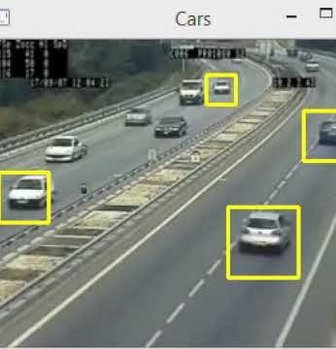
Haar-Cascades
Haar cascades are used for detecting faces, eyes, and various objects in images.
This method is highly efficient in identifying specific features within an image, making it ideal for tasks requiring precise object recognition.
By employing Haar cascades, we can accurately detect and focus on regions of interest, which significantly improves the quality and relevance of the data used for training our machine learning models.
Additionally, Haar cascades are widely utilized due to their robustness and speed, making them suitable for real-time applications.

Slide 8
Why I have used only Haar-cascade but not CNN??

Slide 9
Why not??
I chose to use Haar cascades over CNNs for the initial face and eye detection stage primarily due to the following reasons:
Speed and Effciency
Simplicity
Resource Management
Historical performance

Slide 10
Why I have used??
I chose Haar cascades over CNNs for face and eye detection due to their
Simplicity
faster processing speed
lower computational requirements
Haar cascades are efficient for real-time applications and do not require extensive training data, making them ideal for the preprocessing phase of this project. This allowed me to focus more on building and optimizing the classification models.

Slide 11
Explanation
Speed and Efficiency: Haar cascades are significantly faster and computationally less demanding compared to CNNs. This makes them ideal for real-time detection tasks where quick processing is essential.
Simplicity: Haar cascades are simpler to implement and require less tuning compared to CNNs. For the preprocessing phase, where the goal is to quickly and reliably detect faces and eyes, Haar cascades offer a straightforward and effective solution.
Resource Management: By using Haar cascades for initial detection, computational resources are preserved for more intensive tasks later in the pipeline, such as training the classification model. This is particularly important when working with limited computational resources.
Historical Performance: Despite being an older technique, Haar cascades have been proven to be highly effective for detecting faces and eyes in a variety of conditions. Their reliability in this specific task makes them a suitable choice for preprocessing.

Slide 12
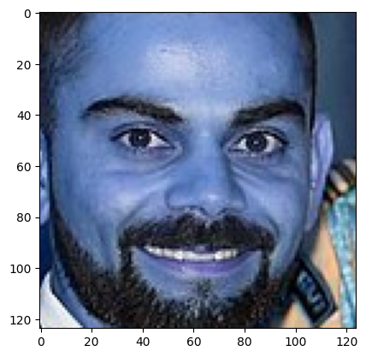
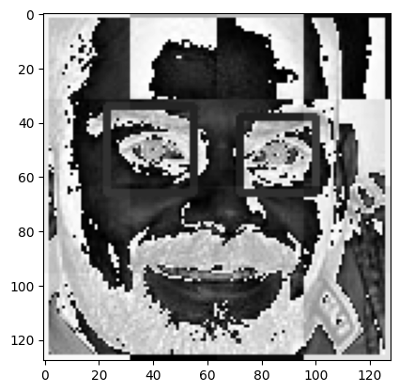
Region of Interest
Differentiating all the facial features such as eyes nose and mouth etc.
Wavelet Transformation

Slide 13
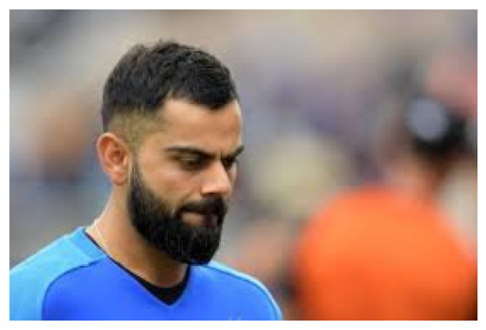
Preprocessing
Load image, detect face. If eyes >=2, then save and crop the face region
No eyes are matched from the previous images
Above image 2 eyes is None which means we should ignore this image and we will not use such image for model training

Slide 14
Data Cleaning
Made the folders automatically with some lines of code
Created a script to automatically generate the necessary folder structure for organizing the image dataset into main directories and subdirectories for different categories, ensuring consistency and efficiency.
Manually examine cropped folder and delete any unwanted images
Reviewed the automatically cropped images, identified and removed any misaligned or irrelevant images to maintain the quality of the dataset.

Slide 15
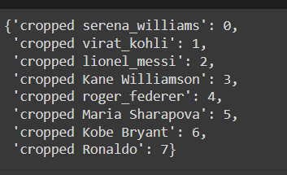
Created a Dictionary

Slide 16
Grid Search
GridSearch is a technique used in machine learning for hyperparameter tuning.
It helps in finding the best combination of hyperparameters for a given model by exhaustively searching over a specified parameter grid.
This ensures that the model performs optimally by selecting the set of hyperparameters that results in the highest performance metric on the validation set.

Slide 17
Grid Search
Support Vector Machines (SVM), Random Forests, and Logistic Regression are three widely used machine learning models, each with its unique strengths and applications. SVMs are powerful classifiers that work by finding the optimal hyperplane that best separates the classes in the feature space. They are particularly effective in high-dimensional spaces and for tasks with small to medium-sized datasets, utilizing techniques like the kernel trick to handle non-linear data.
Random Forests, on the other hand, are an ensemble learning method that builds multiple decision trees and merges their results to improve accuracy and control overfitting. This approach, known as bagging, ensures robust performance on large datasets and can handle a significant number of input features, providing insights into feature importance as well.
Logistic Regression is a fundamental statistical method used for binary classification problems. It models the probability of a particular class and outputs a probability score, making it useful for tasks where understanding the likelihood of an outcome is important. Its simplicity, ease of implementation, and interpretability make it a go-to method for baseline comparisons and problems where the classes are linearly separable. Together, these models offer a versatile toolkit for tackling various classification challenges in machine learning.

Slide 18
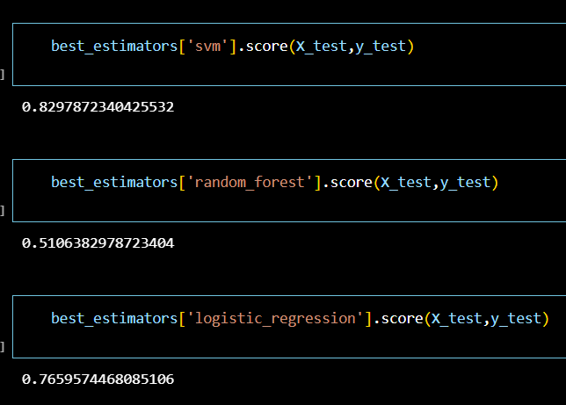
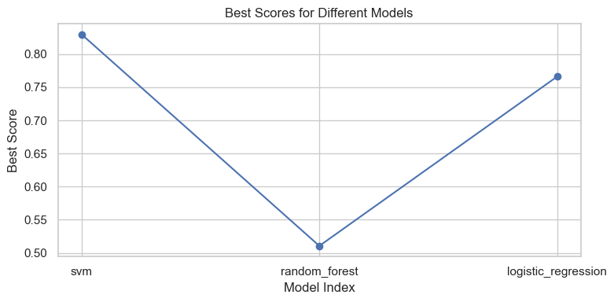
Outputs of Grid Search

Slide 19
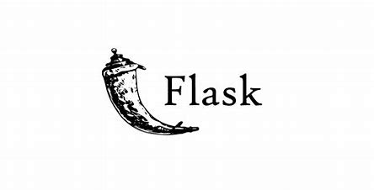
Flask sever
Flask is a light weight framework for web applications
It’s a micro framework
I have started building the flask but its facing some of the issues

Slide 20
Work Done
S no. | weeks | work done
1 | week 1 | collected data
2 | week 2 | selected a image and grayscaled the image
3 | week 3 | used wavelet transformation
4 | week 4 | created dictionary
5 | week 5 | cropped images folder and arranged them accordingly
6 | week 6 | grid search
7 | week 7 | trained svm logistic regression and random foreat models
8 | week 8 | flask sever
9 | week 9 | flask sever
10 | week 10 | report
And the work is still pending

Slide 21



